Slide 1









UnLynx: framework for privacy-conscious data sharing
[Froelicher et al PET’17]
Untrusted Collective Authority
Processing Server
Trust is shared across a group of servers forming a collective authority
They collaborate together to generate a collective encryption key
The collective encryption key is used to encrypt the data and can be compromised only if all servers are compromised
Querier
Data Provider 1
Data Provider 6
Data Provider 2
Data Provider 3
Data Provider 5
Data Provider 4
collective authority public key
servers public keys
=
+
+
servers private keys

Slide 2


MedCo: Privacy-conscious medical data sharing
Main features:
Secure outsourcing enabled by collective encryption of the data
End-to-end data protection through homomorphic encryption
Compliance wrt to regulations (e.g., GDPR)
Increased flexibility and lower costs wrt standard approaches of data sharing
Governmental SPU
Clinical Site
Clinical Site
Clinical Site with local SPU
Cloud-based SPU
Clinical Site
Raisaro JL, Troncoso-Pastoriza JR, Misbach M, Gomes de Sá ES, André J, Pradervand S, Missiaglia E, Michielin O, Ford BA, Hubaux JP. MedCo: Enabling Secure and Privacy-Preserving Exploration of Distributed Clinical and Genomic Data. Accepted for publication in IEEE/ACM Transactions in Computational Biology and Bioinformatics

Slide 3

MedCo: Combining the best of Information Security and Medical Informatics
Data model
Interoperability layer
Meta API
Privacy-preserving
computing framework
Modern GUI
DISCLAIMER MedCo is a generic concept and it is not fundamentally tied to these technologies, but can be adapted and integrated to other ones

Slide 4

MedCo secure query protocol
A, B) ETL & Encryption Phase
(user) Query Generation
(distributed) Query Tagging
(local) Query Processing
(local) Result Aggregation
(local) Result Obfuscation
(distributed) Results Shuffling
(distributed) Results Re-Encryption
(user) Result Decryption
(K₁, k₁)
(K₄,k₄)
(K₃, k₃)
(K_{u}, k_{u})
ETL: extract, transform, load (Database operations)
Sites’ public keys
Sites’ secret keys
Collective public key

Slide 5

MedCo: ETL & encryption phase
- sensitive
- not sensitive
Concept Dimension – local i2b2
Concept_path | Concept_CD
path_1 | code_1
path_2 | code_2
path_3 | code_3
path_4 | code_4
Patient Dimension
Patient_Num
0000001
0000002
Patient Dimension – local i2b2
Patient_Num | isReal
0000001 | 1
0000002 | 1
0000003 | 0
Observation Fact - MedCo
Patient_Num | Concept_CD
0000001 | code_B
0000001 | code_C
0000001 | code_A
0000002 | code_B
0000002 | code_D
0000003 | code_C
0000003 | code_A
Observation Fact – local i2b2
Patient_Num | Concept_CD
0000001 | code_1
0000001 | code_2
0000001 | code_3
0000002 | code_1
0000002 | code_4
Frequency Attack!!
auxiliary
information
Homomorphic
Encryption
Homomorphic
Encryption
path_1
path_2
Patient Dimension - MedCo
Patient_Num | isReal
0000001 | rteiqugfhb
0000002 | vbwiygw=
0000003 | fhbfg72=g
Concept Dimension
Concept_path | Concept_CD
griabfiyqeg | code_B
fgeiwbgohg | code_C
path_3 | code_A
path_4 | code_D
Concept Dimension - MedCo
Concept_path | Concept_CD
fagvfuafygf | code_B
tgybyggyyg | code_C
path_3 | code_A
path_4 | code_D
DDT
tgybyggyyg
fagvfuafygf

Slide 6
MedCo secure query protocol
(user) Query Generation:
(K₁, k₁)
COUNT(DISTINCT(patient_Num)) FROM Observation Fact
WHERE Concept_path = path_2 AND Concept_path = path_3
…
(K₄,k₄)
Homomorphic
Encryption
COUNT(DISTINCT(patient_Num)) FROM Observation Fact
WHERE Concept_path = hf78e2ib78ffg AND Concept_path = path_3
…
(K₃, k₃)
1
(K_{u}, k_{u})
Sites’ public keys
Sites’ secret keys
Collective public key

Slide 7
MedCo secure query protocol
(distributed) Query Tagging:
(K₁, k₁)
COUNT(DISTINCT(patient_Num)) FROM Observation Fact
WHERE Concept_path = hf78e2ib78ffg AND Concept_path = path_3
…
2
DDT
(K₄,k₄)
SELECT(DISTINCT(patient_Num)) FROM Observation Fact
WHERE Concept_path = tgybyggyyg AND Concept_path = path_3
…
(K₃, k₃)
1
(K_{u}, k_{u})
Sites’ public keys
Sites’ secret keys
Collective public key

Slide 8

MedCo secure query protocol
(local) Query Processing:
SELECT(DISTINCT(patient_Num)) FROM Observation Fact
WHERE Concept_path = tgybyggyyg AND Concept_path = path_3
…
(K₁, k₁)
3
3
3
2
(K₄,k₄)
(K₃, k₃)
3
1
(K_{u}, k_{u})
0000001 | rteiqugfhb
0000003 | fhbfg72=g
Sites’ public keys
Sites’ secret keys
Collective public key

Slide 9

MedCo secure query protocol
(local) Result Aggregation:
(K₁, k₁)
3, 4
0000001 | rteiqugfhb = E(1)
0000003 | fhbfg72=g = E(0)
3, 4
3, 4
2
Homomorphic
Addition
(K₄,k₄)
Result | yfgqebfiqy = E(1 + 0)
(K₃, k₃)
3, 4
1
(K_{u}, k_{u})
Sites’ public keys
Sites’ secret keys
Collective public key

Slide 10
MedCo secure query protocol
(local) Result Obfuscation:
(K₁, k₁)
3, 4, 5
Result | yfgqebfiqy = E(1 + 0)
3, 4, 5
3, 4, 5
2
(K₄,k₄)
Homomorphic
Addition
random noise “x” from
Laplacian distribution
(K₃, k₃)
3, 4, 5
1
Obfuscated Result | fiqubgfwbi = E(1 + 0 + x)
(K_{u}, k_{u})
Sites’ public keys
Sites’ secret keys
Collective public key

Slide 11
MedCo secure query protocol
(distributed) Results Shuffling:
(K₁, k₁)
3, 4, 5
Result₁ | yfgqebfiqy = E(1)
Result₂ | f3rngi3rng= E(5)
Result₃ | nfeingbrbd= E(10)
Result₄ | vnnvnvugin= E(2)
3, 4, 5
3, 4, 5
2, 6
(K₄,k₄)
DVS
Result₁ | friguhr4bgg= E(5)
Result₂ | fuerifkmsdi= E(10)
Result₃ | tztueisnvjbv= E(2)
Result₄ | g49scjnr4ibg= E(1)
(K₃, k₃)
3, 4, 5
1
(K_{u}, k_{u})
Sites’ public keys
Sites’ secret keys
Collective public key

Slide 12
MedCo secure query protocol
(distributed) Results Re-Encryption
(K₁, k₁)
3, 4, 5
Result₁ | friguhr4bgg= E(5)
Result₂ | fuerifkmsdi= E(10)
Result₃ | tztueisnvjbv= E(2)
Result₄ | g49scjnr4ibg= E(1)
3, 4, 5
3, 4, 5
2, 6, 7
(K₄,k₄)
DKS
Result₁ | friguhr4bgg= E(5)
Result₂ | fuerifkmsdi= E(10)
Result₃ | tztueisnvjbv= E(2)
Result₄ | g49scjnr4ibg= E(1)
(K₃, k₃)
3, 4, 5
1
(K_{u}, k_{u})
Sites’ public keys
Sites’ secret keys
Collective public key

Slide 13
MedCo secure query protocol
(user) Results Decryption
(K₁, k₁)
3, 4, 5
Result₁ | friguhr4bgg= E(5)
Result₂ | fuerifkmsdi= E(10)
Result₃ | tztueisnvjbv= E(2)
Result₄ | g49scjnr4ibg= E(1)
3, 4, 5
3, 4, 5
2, 6, 7
(K₄,k₄)
Decryption
Result₁ | 5
Result₂ | 10
Result₃ | 2
Result₄ | 1
(K₃, k₃)
3, 4, 5
1, 8
(K_{u}, k_{u})
Sites’ public keys
Sites’ secret keys
Collective public key

Slide 14
MedCo deployment at a clinical site
Clinical site’s zoomed-in view
EHR System
MedCo Cell
PIC-SURE API
i2b2
Cell
i2b2
encrypted database
i2b2
Cell
Encrypted
Data
Exit
i2b2
Cell
Clinical
Data
Warehouse
MedCo ETL
i2b2
Cell
I2b2 hive
CLinical (non-connected) zone
Research (connected) zone
ETL: Extraction Transformation (Encryption) and Loading tool
Clear data
Encrypted data

Slide 15
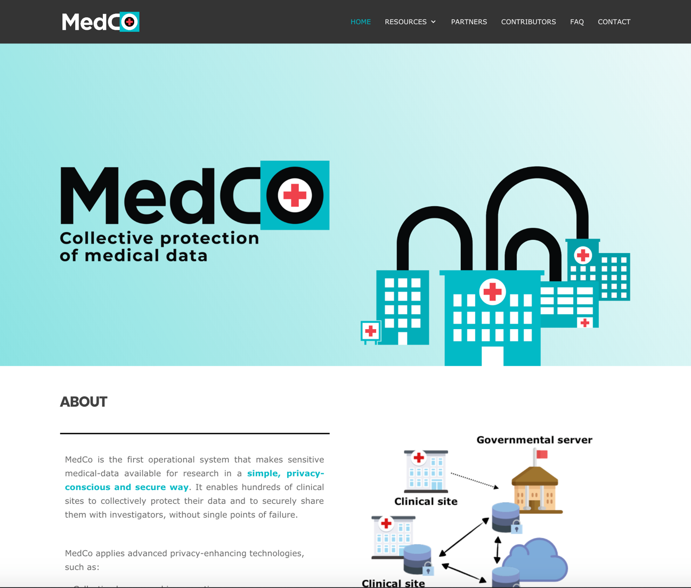
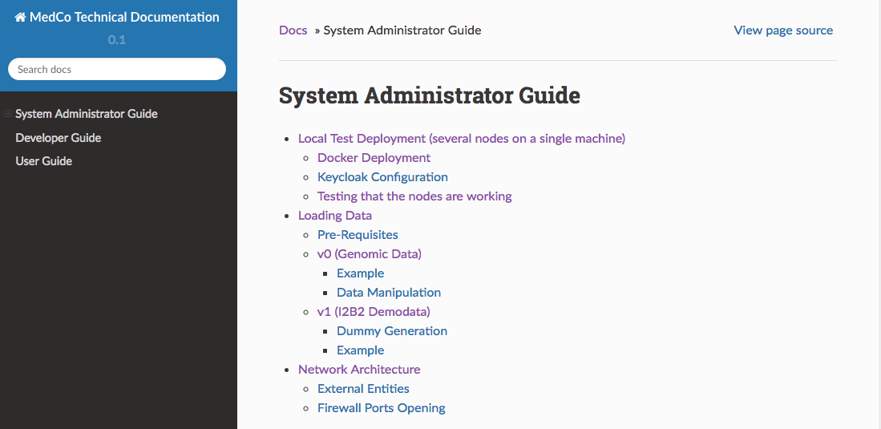
MedCo Web site and documentation
https://medco.epfl.ch/
https://lca1.github.io/medco-documentation/index.html
Notes:
Add doc screenshot and url

Slide 16

What will happen in the demo
0.
Each CS encrypts and stores their data locally
0.
0.
1.
The querier fetches the genomic IDs (numeric representation for a genomic variant) that match his/her query.
Clinical Site (CS)
Clinical Site
2.
Both the genomic IDs and the clinical attributes (e.g., Cutaneous Melanoma = TRUE) are encrypted.
0.
4.
3.
3.
The query is sent to a node (e.g. that can belong to a CS or another entity).
Clinical Site
Node
0.
Node
4.
The query is broadcast to the other nodes. The encrypted values are matched to the values in each of the CSs’ databases (using a series of protocols that are collectively executed by all the nodes).
5.
1. & 2.
Clinical Site (CS)
0.
Clinical Site (CS)
5.
The results, which are still encrypted, are sent to the querier that can decrypt them.
Querier/Researcher

Slide 17


Slide 18
Test on clinical oncology use case
Experimental Setup:
3 clinical sites with one SPU each
8,000 patients at each site with >1 million clinical and genetic attributes from The Cancer Genome Atlas
Query: “Number of patients with skin cutaneous melanoma AND a mutation in BRAF gene affecting the protein at position 600.”
HW/SW configuration: 3 servers (2.5.GHz Intel Xeon E5-2680 v3 CPU with 12 cores); 256GB of RAM; Postgres SQL; ElGamal on Ed25519 with 128 bits security; UnLynx library (Froelicher et al.’17)

Slide 19
Query runtime break-down

Slide 20
Step 2: Secure and Decentralized Computation on the Selected Records
Features
Fully decentralized architecture
Data stay with each data provider
Resistance against colluding, malicious adversaries
Linear regression and logistic regression are computable under homomorphic encryption
Current research: extension to neural networks
More on this in a few months ☺
…

Slide 21

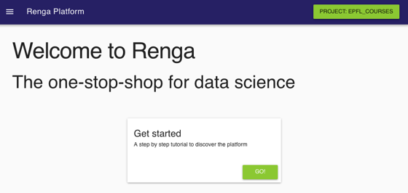


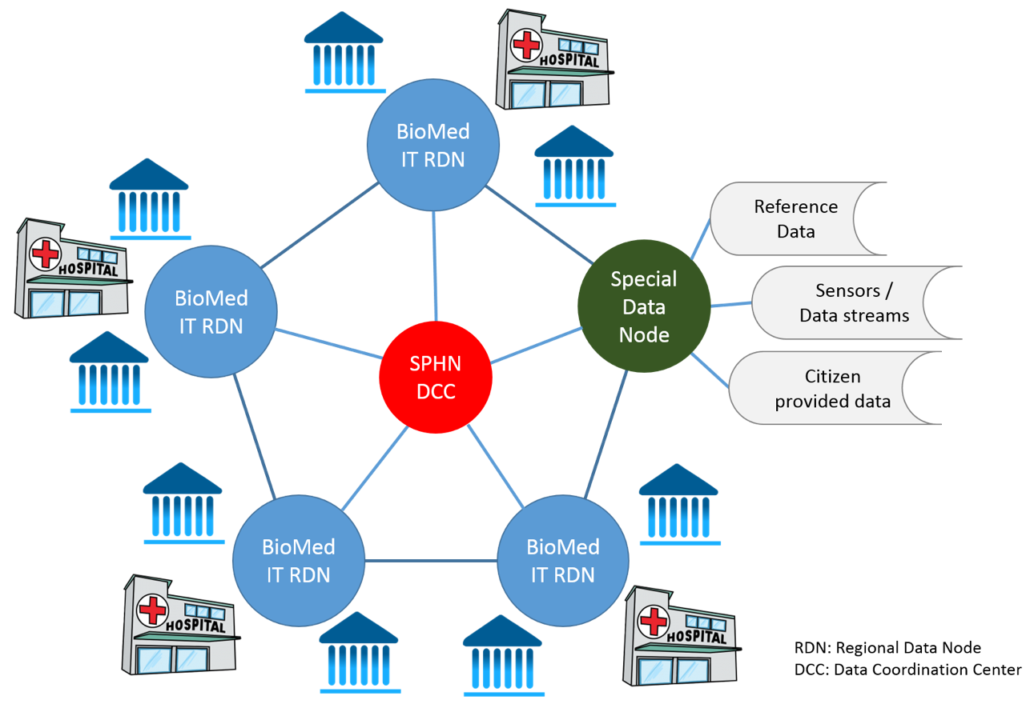
DPPH – The Role of the Blockchain
DPPH Blockchain
Distributed Access Control
Distributed Privacy-conscious Processing
IT
Node
IT
Node
Immutable Log
Inference resistance
IT
Node
DCC
Provenance and Reproducibility
Big Data Platform
IT
Node
IT
Node
DCC: Data Coordination Center
We use a private blockchain, unlike Bitcoin that uses a public blockchain.

Slide 22
Blockchain as immutable log of data access
How many patients have a mutation in BRCA1 gene?
Block X-1
Block X
Block X+1
Bob
Block X
Hash(Block X-1)
Researcher identity: {Bob}
Data Source: {H1, H2, H3}
Data Request: {numb of patients with a mutated BRCA1 gene}
Result : {Encrypted}
Timestamp: {11Apr18_08:15}
Hospital H1
Hospital H2
Hospital H2
Hospital H3

Slide 23
Data Protection for Personalized Health
At the international level:
GA4GH has its own workstream on data security
Swiss Personalized Health Network

Slide 24
Data Protection for Personalized Health
At the international level:
GA4GH has its own workstream on data security
Swiss Personalized Health Network

Slide 25
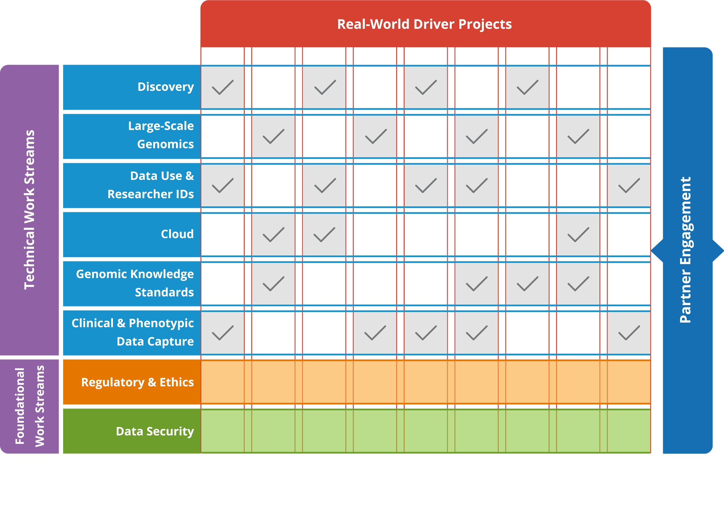
GA4GH Organization

Slide 26

Work Streams vs Driver Projects
Work Streams
Internal to GA4GH
Deliver standards and policy frameworks based on the Strategic Roadmap
Run by 2 volunteer Leads within the community
Contributors come from a variety of projects and organizations
Driver Projects
External to GA4GH
Provide input towards the Strategic Roadmap and standards development
Contribute FTE resources to Work Streams for standards development
Pilot implementations for new standards
Example:
Example: Data Use and Researcher Identities
26

Slide 27
Data Security
Technology standards and best practices for protecting data
In development
Authentication and authorization infrastructure (AAI): GA4GH standard technical profile for authenticating the identity of individuals seeking to access data and services
Breach Response Protocol: protocol for the GA4GH community to effectively respond to and recover from security breaches
Ongoing discussions
with the Cloud Work Stream
on homomorphic encryption and SMC

Slide 28



Events on Genome Privacy and Security
Dagstuhl seminars on genome privacy and security 2013, 2015
Conference on Genome and Patient Privacy (GaPP)
March 2016, Stanford School of Medicine
GenoPri: International Workshop on Genome Privacy and Security
July 2014: Amsterdam (co-located with PETS)
May 2015: San Jose (co-located with IEEE S&P)
November 12, 2016: Chicago (co-located with AMIA)
October 15, 2017: Orlando (co-located with Am. Society for Human Genetics (ASHG) and GA4GH)
October 3, 2018, Basel (co-located with GA4GH)
October 21-22, 2019, Boston (co-located with GA4GH)
iDash: integrating Data for Analysis, Anonymization and sHaring (already in previous years)
October 14, 2017: Orlando
Inst. For Pure and Applied Mathematics (IPAM, UCLA)
Algorithmic Challenges in Protecting Privacy for Biomed Data
10-12 January, 2018
DPPH Workshop, 15 February 2018
➔ Lots of material online
DPPH18.epfl.ch

Slide 29


“genomeprivacy.org”
Community website
Searchable list of publications on genome privacy and security
News from major media (from Science, Nature, GenomeWeb, etc.)
Research groups and companies involved
Tutorial and tools
Events (past & future)

Slide 30


















Privacy Challenge in mHealth
Many apps collect the list of installed apps
Presence of an mHealth app → specific medical conditions of its users
Collected lists of installed apps can be shared with third-parties
(1) Request mHealth app
Misuse this info
To profile
To shame
To discriminate users
…
List of apps:
Facebook
Twitter
Play Store
Diabetes
Depression
Cancer.net
(2) mHealth app
Play Store
Facebook
Cancer.Net
Twitter
Depression
Diabetes
Third-party servers
How to hide the presence of a sensitive app from other apps while preserving key functionalities and usability of the app, and without requiring users to modify the OS of their phones?
(1) Request mHealth app
List of installed apps
Facebook
Twitter
Play Store
Diabetes
Depression
Cancer.net
(2) mHealth app
Play Store
Facebook
Diabetes
Twitter
Third-party servers
Third-party servers
Depression
Cancer.Net

Slide 31





Solution: HideMyApp (HMA)
Main idea: Launch the sensitive app without installing it
Technologies used:
Dynamic loading of classes and resources from an application package (APK)
App virtualization
Randomization and obfuscation
HMA Proxy
(1) Request mHealth app
List of apps:
Facebook
Twitter
Play Store
HMA Manager
App-1
App-2
App-3
(3) Disguised mHealth app
HMA Manager
Facebook
App-1
Twitter
App-2
App-3
(2) Fetch the
mHealth app
Play Store
Third-party servers

Slide 32
Conclusion
Protecting health data is one of the most formidable challenges for cybersecurity
With the advent of genomics:
risk is increasing
conventional medical data protection techniques based on de-identification do not work anymore
There exist technical solutions to address the problem
Legislation will also play an important role

